Slide 1
ATT: Empathic discovery of art and history
Wolmar Nyberg Åkerström
Jolene Chichigeh
Peter Sjöberg

Slide 2
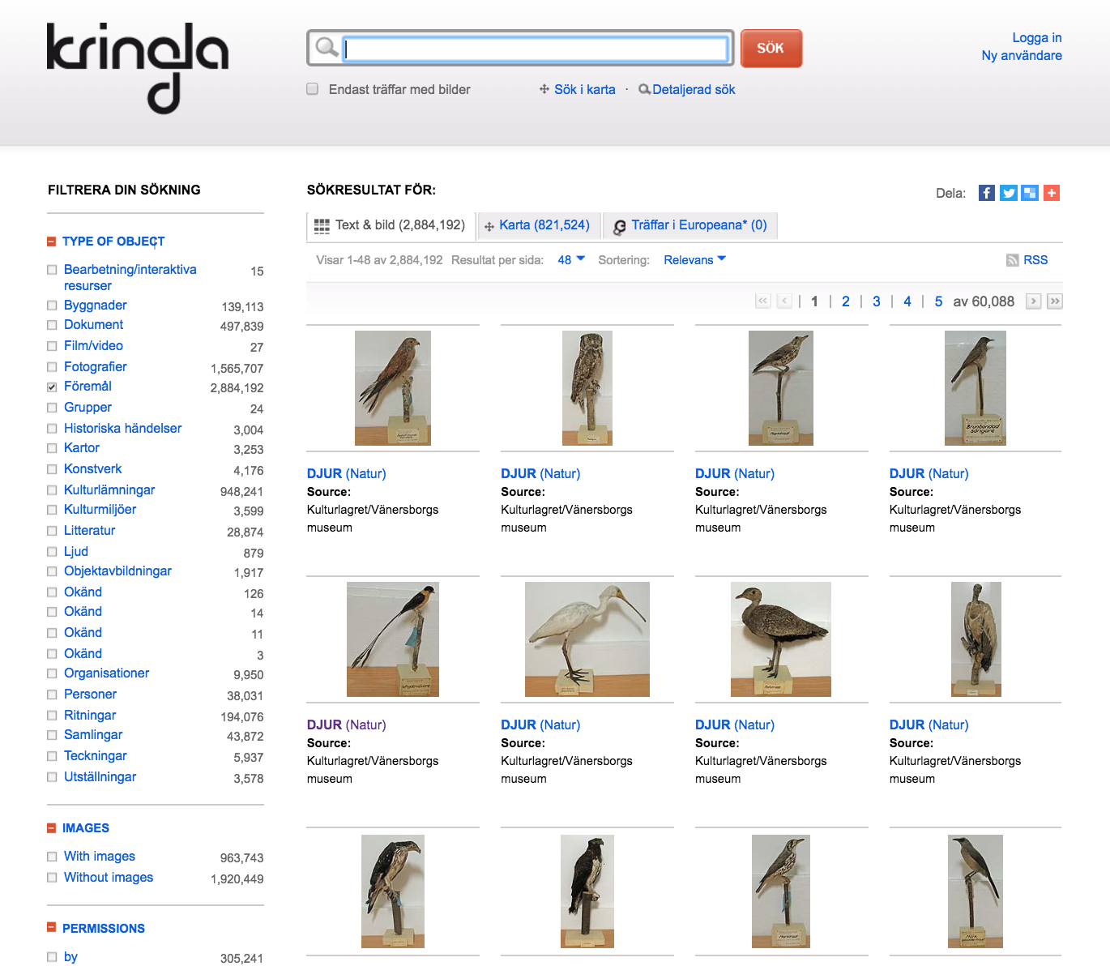
The problem:
The empty search bar

Slide 3
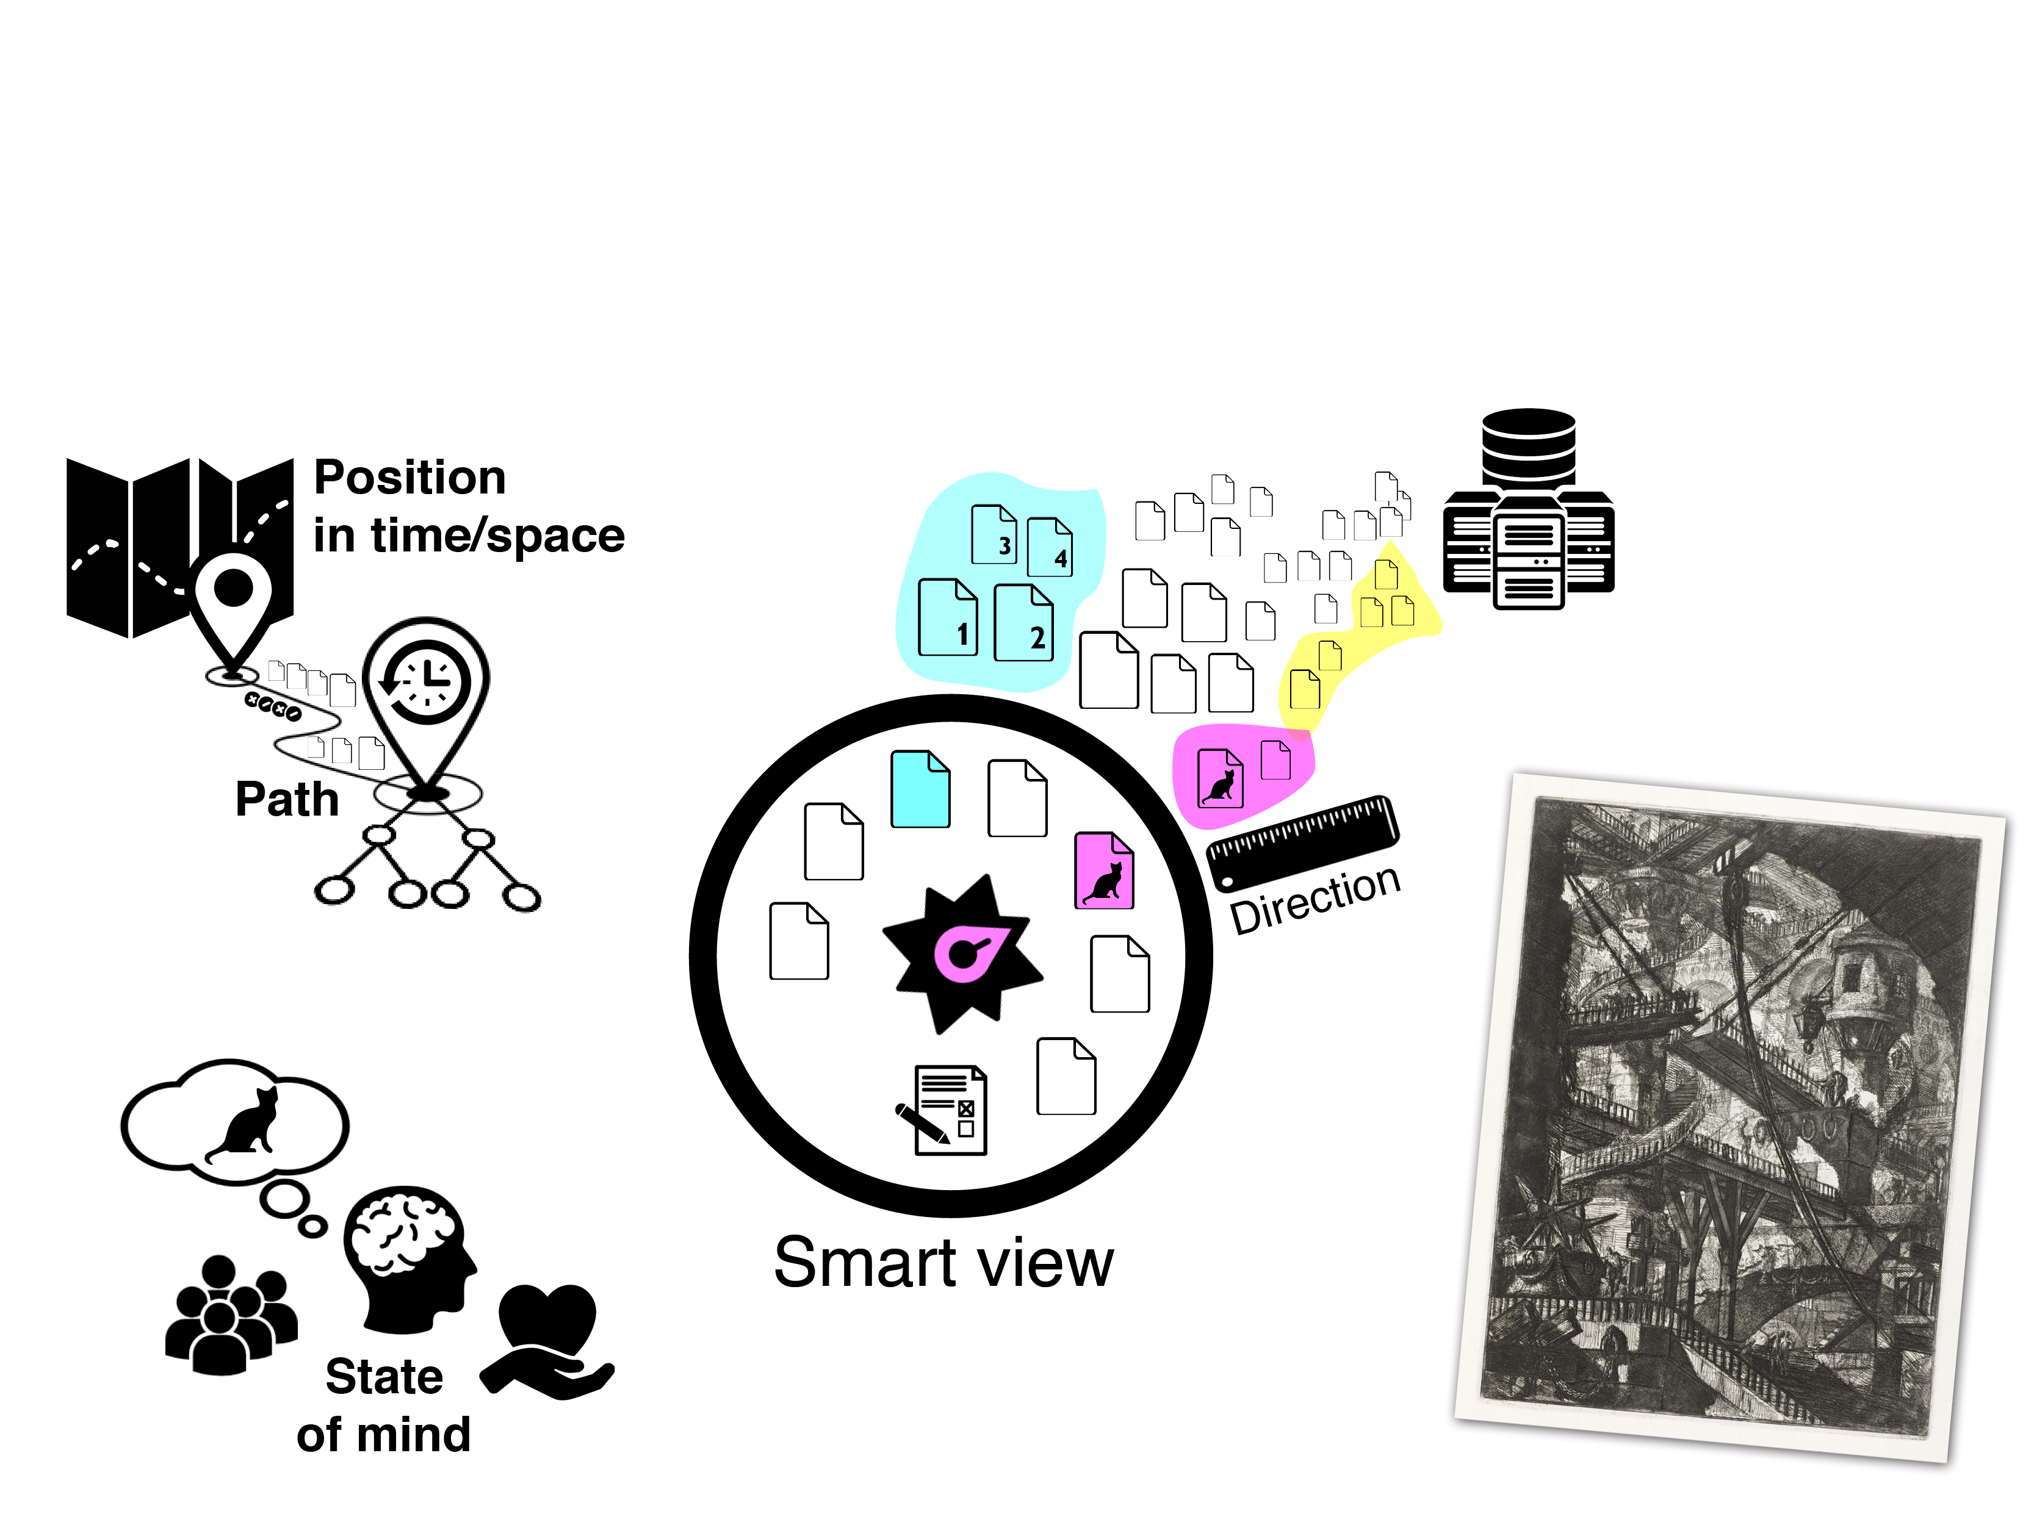
The solution:
Putting the user at the center

Slide 4
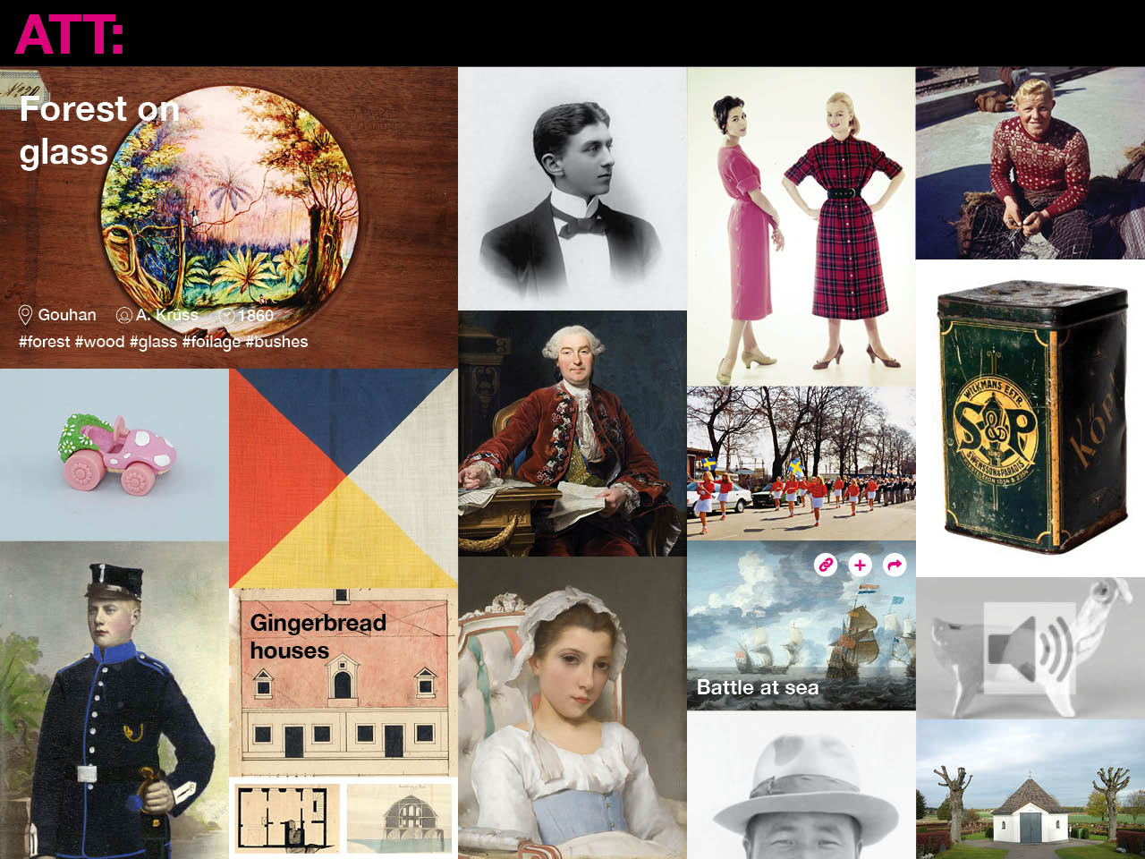

Slide 5
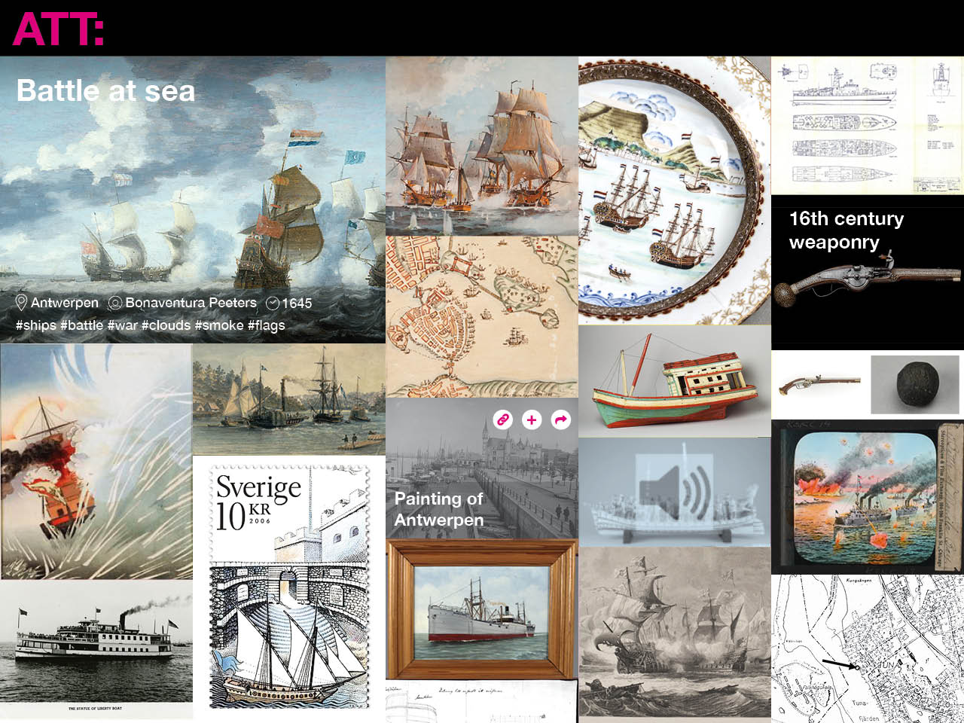

Slide 6

Interface interaction:
Navigation by images

